Slide 1

Search with Scamazon
Group Members:
Ketaki Barde : Frontend Dev, Middleware
Saloni Aggarwal : Backend Dev, Middleware
Yash Mahajan : DevOps (Atlas Server)
Advisor: Prof. Edward Holden
*This website and its content is copyright of the aforementioned members and any form of redistribution is prohibited under Section [999]. You may not, except with our permission exploit it’s content

Slide 2
Outline
Objective
Database description
MERN Stack
Data Preprocessing Pipeline
Backend Development
Frontend Development
Architecture Diagram
Code Demo and Review

Slide 3
Objective
Build Amazon Search API to accomplish :
Search products using filters (Name, Category, Zip code location)
Include available product images
Display Product details including reviews and google maps
Ability to add comment to a specific product
End/Restart session service
Notes:
@Yash : Please tell about these tasks as rubrics (means criteria for marks) given by the professor. This is our objective of the project
Also mention - Its a Full stack development task

Slide 4
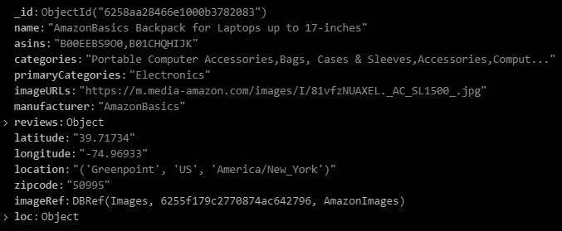
Database
MongoDB store snapshot
Database name: amazon, Collection name: products
Consists of data about amazon products belonging to different categories
Fields:
Name
Primary Category
Zip and location info
Product images
Many more…
Notes:
@Yash : Many more has reviews which has subcategories which aren’t of primary importance so while talking mention we have review attributes also instead of many more!

Slide 5
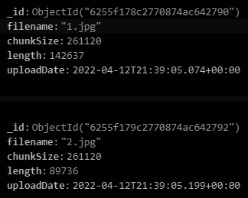
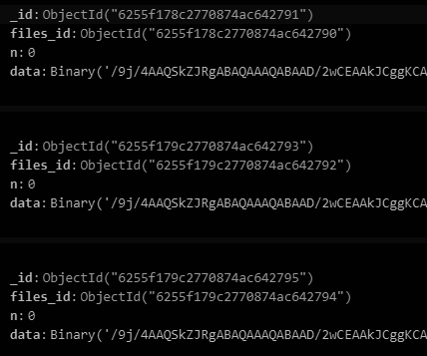
Database :
GridFS Images
Database name: AmazonImages
Files chunks
Notes:
@Yash – Just tell we used GridFS

Slide 6
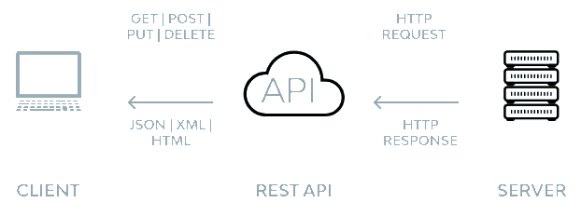
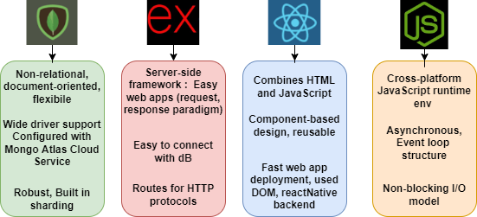
MERN Stack
Stands for MongoDB, Express JS, React JS and Node.js framework.
MERN is a RESTful Full Stack Architecture
Notes:
@Yash →
Why this tech stack? REST! MOST IMP!!!! – Representational State Transfer: allows communication between backend programs and web servers using higher level communication protocols like HTTP (GET, POST).
Layered Architecture, stateless(not constrained by xml like SOAP), flexibility, scalability

Slide 7
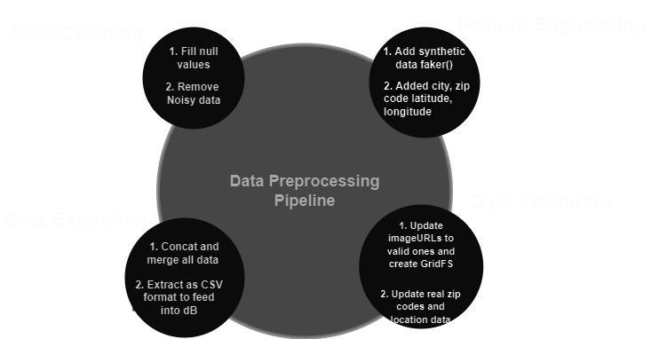
Data Preprocessing pipeline

Slide 8
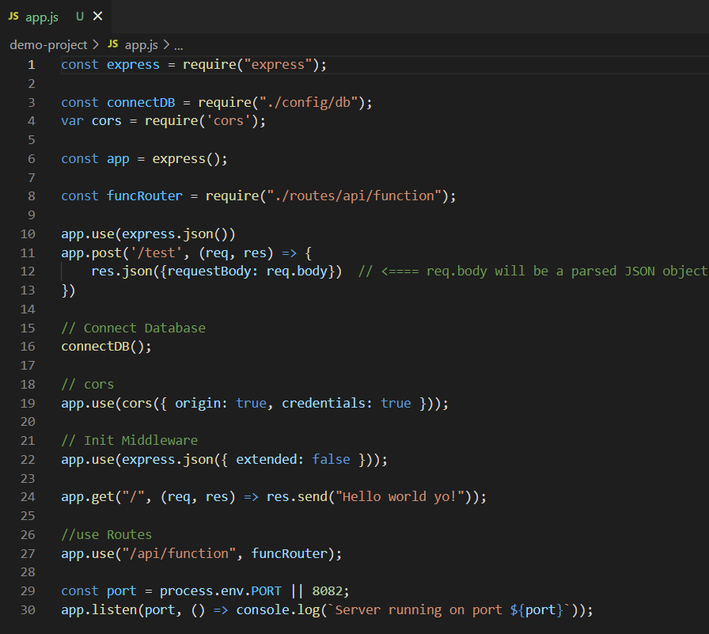
Backend Architecture
Example Code: Main Page
Node.js - server side proxy for simultaneous connections
Mongoose - Object Data Modelling (ODM) library for MongoDB
Express - wraps http requests and response easily
Cors - Access restricted functionality from a browser
Router - create a new router object for every api (find and update) made

Slide 9
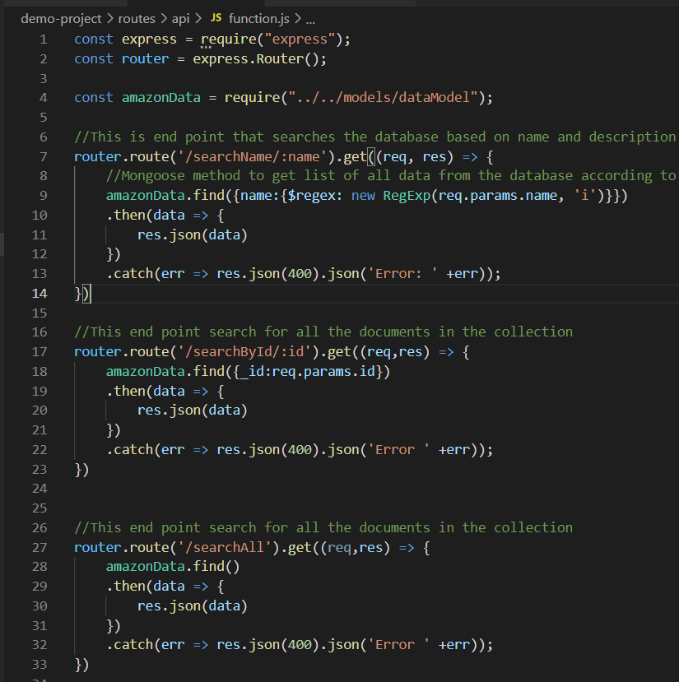
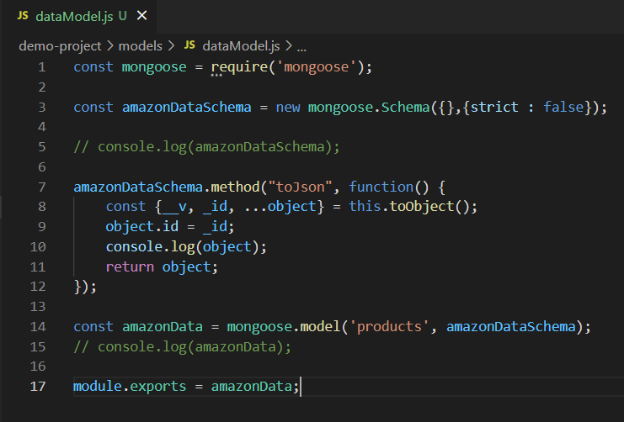
Backend Screenshots

Slide 10
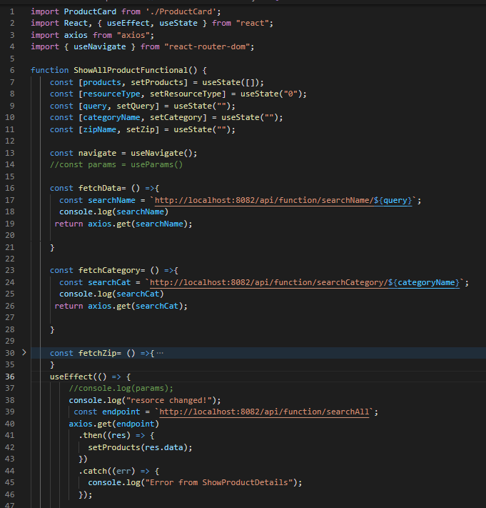
Frontend Architecture
Example Code : Main Page
React Functional Components - building block
React Hooks (useState, useEffect, useNavigate)
Axios for GET,POST request/response , Routes to navigate
JSX (JavaScript HTML) to include HTML rendering
Major components:
Retrieve and view all available products
Filter/Search by Name, Category, Zip
Product Card (Google Map function) container to hold specific product data.
Ability to post a comment
End session and return to search

Slide 11
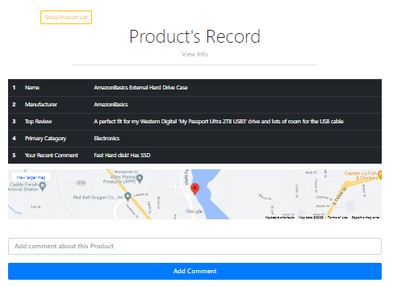
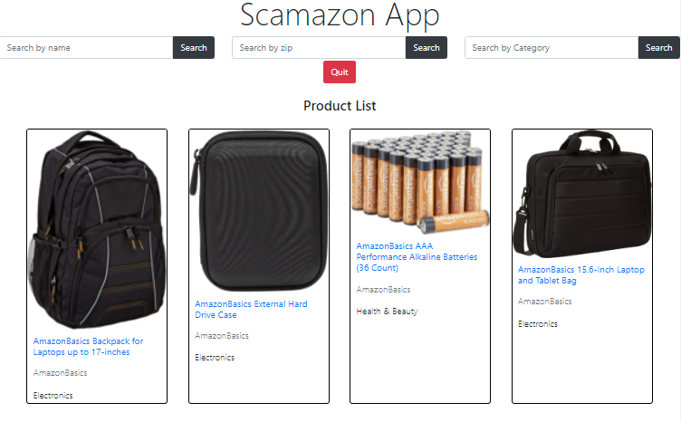
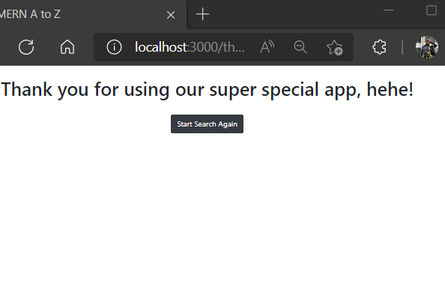
Screenshots:

Slide 12
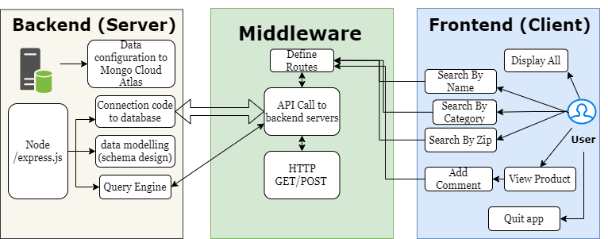
Flowchart Logic Diagram

Slide 13
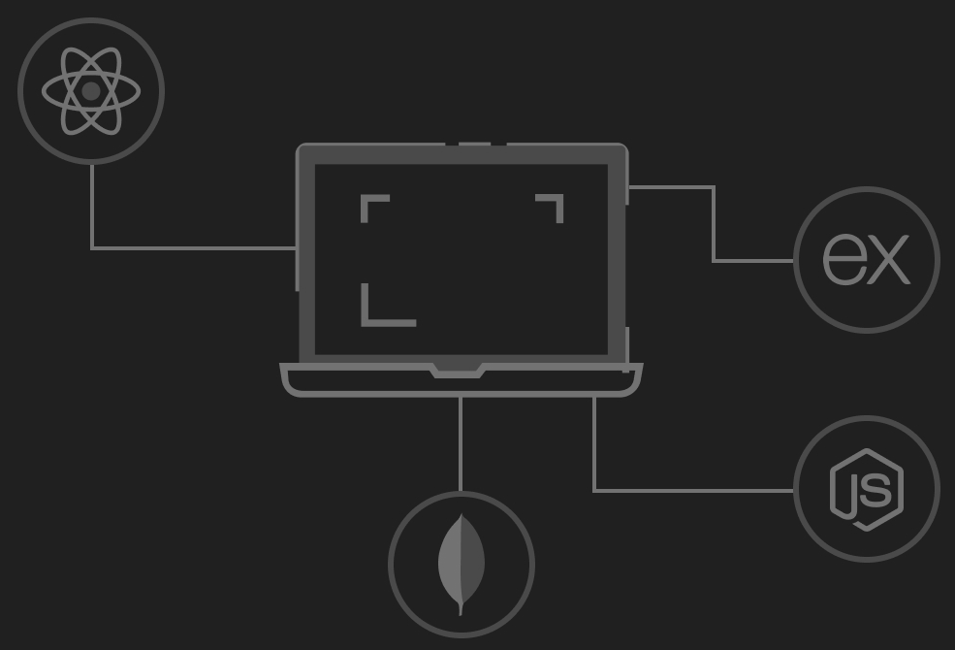
Project Demo
Thank You!

